Slide 1
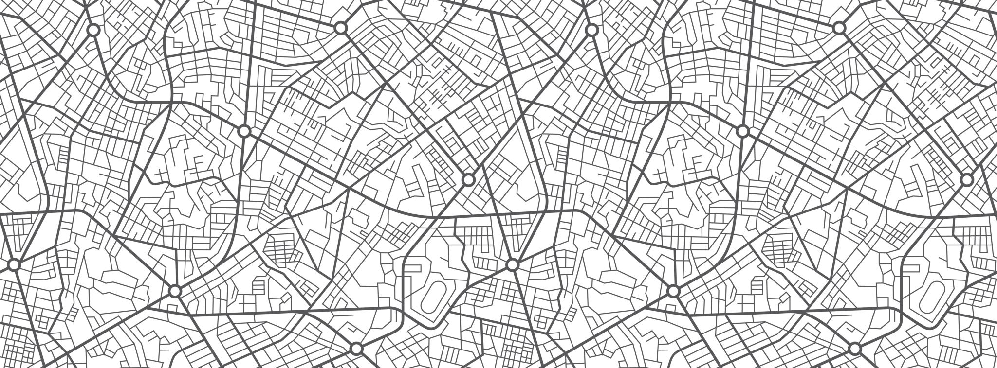
Cyrtids

Slide 2
Contrast between two maps
Purpose of map
Inclusion of map elements and why

